Slide 1
ECE 333 Green Energy Systems
Lecture 10: Photovoltaic Arrays
Dr. Karl Reinhard
Dept. of Electrical and Computer Engineering
University of Illinois at Urbana-Champaign
reinhrd2@illinois.edu

Slide 2
Announcements
Reading Chapter 5
HW 5:
For Quiz 5
5.2, 5.3, 5.4, 5.5, 5.7, 5.8, 5.10, 5.11
Additional problem
Before Midterm Exam 1
5.6, 5.7, 5.9
Quiz 5: 22 Feb 18
Midterm Exam 1
1 Mar 18 (Thursday – 2 weeks) During class period
1 page of notes – blanks provided – will be turned in.

Slide 3
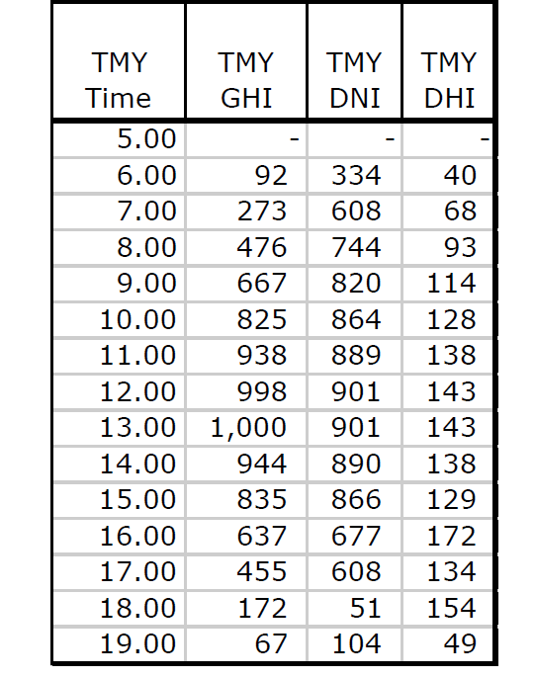
Problem 4.11 (Section 4.13)
Typical Meteorological Year (TMY)
Global Horizontal Irradiance (GHI) Direct Normal Irradiance (DNI) Diffuse Horizontal Irradiance (DHI)
DNI – direct beam
DHI – diffuse beam GHI – reflected beam
TMY datasets used in solar energy system computer simulations
Enable production estimates and performance comparisons of different system types and configurations
https://nsrdb.nrel.gov/tmy accessed 14 Feb 18

Slide 4
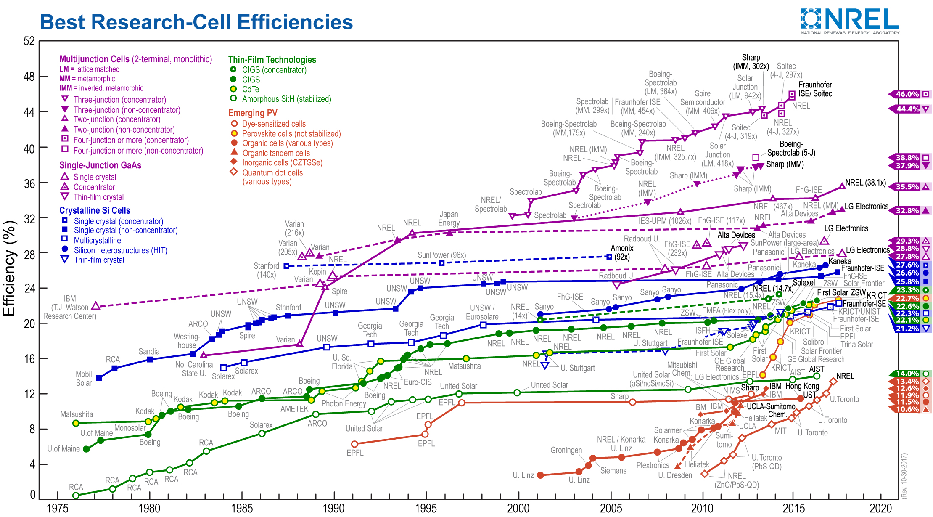
Many Different PV cell Materials
3 Technologies Dominate:
Monocrystalline Si
Polycrystalline Si (p-Si)
Thin Film
Courtesy of the National Renewable Energy Laboratory, Golden, CO.
https://www.nrel.gov/pv/assets/images/efficiency-chart.png accessed 9 Feb 18
Notes:
Notes accompanying NREL PV efficiency-chart.png
https://www.nrel.gov/pv/assets/pdfs/cell_efficiency_explanatory_notes.pdf (accessed 9 Feb 2018)
The National Renewable Energy Laboratory (NREL) maintains a plot of compiled values of highest confirmed conversion efficiencies for research cells, from 1976 to the present, for a range of photovoltaic technologies.
Devices included in this plot of the current state of the art have efficiencies that are confirmed by independent, recognized test labs (e.g., NREL, AIST, Fraunhofer) and are reported on a standardized basis. The measurements for new entries must be with respect to Standard Test or Reporting Conditions (STC) as defined by the global reference spectrum for flat-plate devices and the direct reference spectrum for concentrator devices as listed in standards IEC 60904-3 edition 2 or ASTM G173. The reference temperature is 25°C and the area is the cell total area or the area defined by an aperture.
Cell efficiency results are provided within different families of semiconductors: (1) multijunction cells, (2) single-junction gallium arsenide cells, (3) crystalline silicon cells, (4) thin- film technologies, and (5) emerging photovoltaics. Some 26 different subcategories are indicated by distinctive colored symbols.
The most recent world record for each technology is highlighted along the right edge in a flag that contains the efficiency and the symbol of the technology. The company or group that fabricated the device for each most-recent record is bolded on the plot.
The information plotted by NREL is provided in good faith, but NREL cannot accept direct responsibility for any errors or omissions. The plot is not copyrighted and may be used in presentations and publications, with a notation included that states: “This plot is courtesy of the National Renewable Energy Laboratory, Golden, CO.”

Slide 5
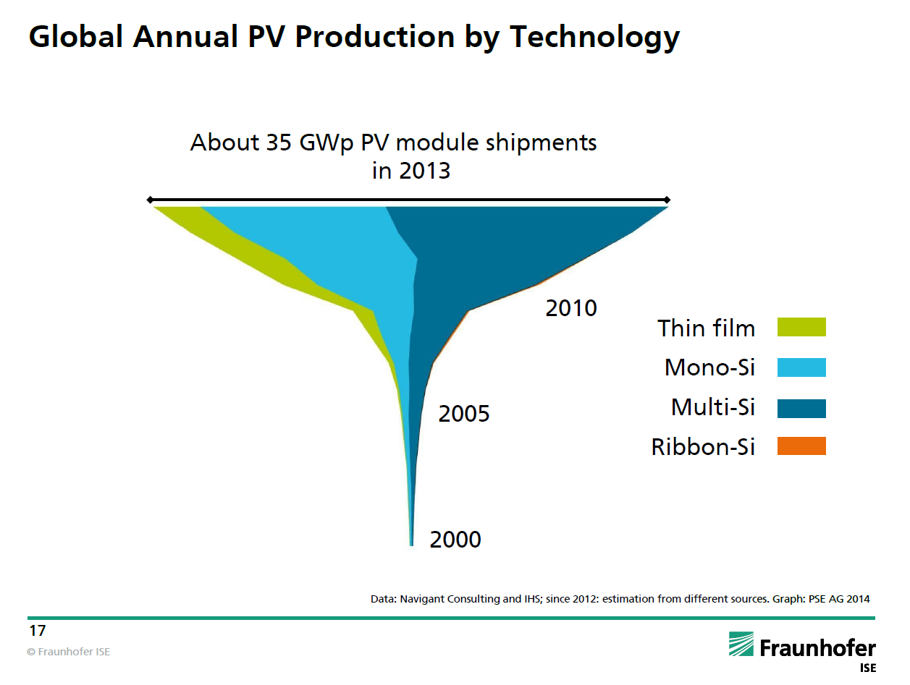
PV Material Market Share
Note that silicon continues to dominate in market share
Source: http://www.ise.fraunhofer.de/en (Photovoltaics Report, July 2014)

Slide 6
Single Cell V-I Terminal Relationship
Equivalent Circuit
Assume
I₀ = 5×10⁻¹¹ A
I_{sc} = 5A,
R_{p} = 5Ω,
R_{s} = 0.01 Ω
At 25°C what is V_{oc}?
R_{s}
I_{sc}
(minimize)
Photocurrent source
Load
R_{P}
(maximize)
Cannot explicitly solve this equation, but an iterative solution can be found… choose V_{d} and solve using Newton's method).
Choose V_{d} = 0.65, next iteration is 0.6504.

Slide 7
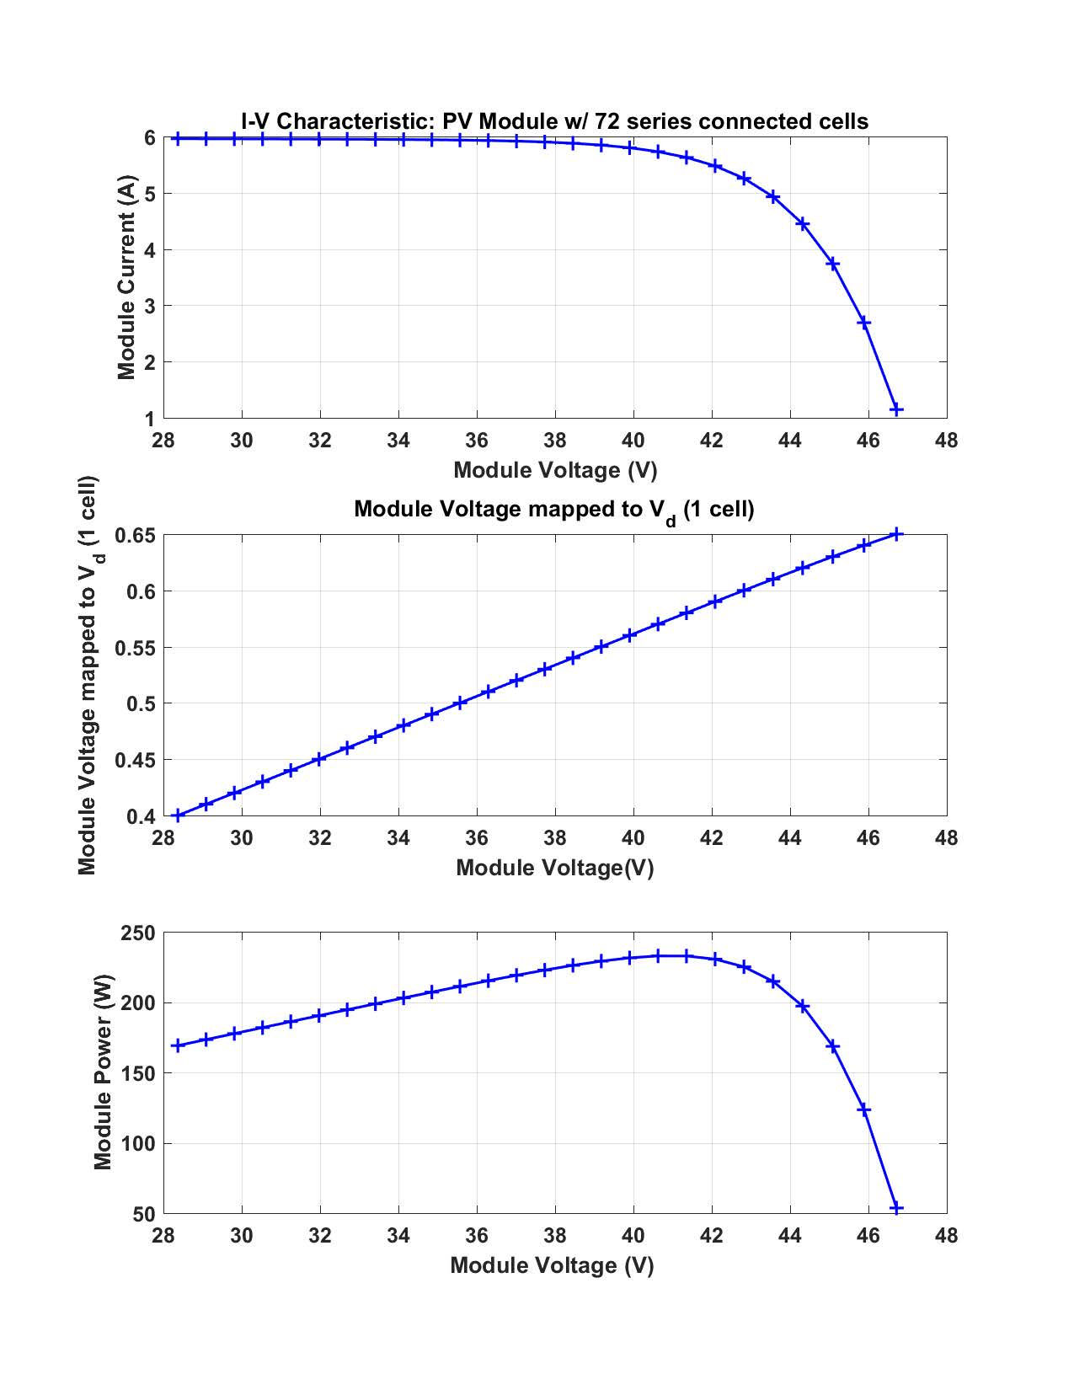
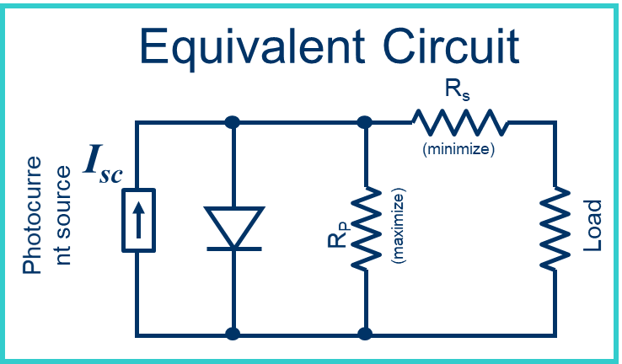
Single Cell V-I Terminal Relationship (cont)
To generate the terminal V-I Curve
Pick a V_{d} value
Solve for I_{d}
Solve of I_{p}
I = I_{sc} – I_{d} - I_{p}
V = V_{d} - R_{s}· I

Slide 8
Cells as Building Blocks
Solar cell V_{oc} is ~ 0.6 V and ~ loaded cell V is ~ 0.5 V 0.5
V is low for power applications → single cell is impractical
→ Wire individual cells in series – a module &
encase module in a tough, weather-resistant package
Modules are in-turn wired into arrays

Slide 9
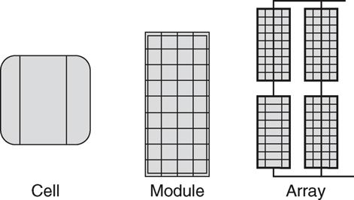
Cells to Modules to Arrays
FIGURE 5.33 Photovoltaic cells, modules, and arrays.
Masters, Gilbert M. Renewable and Efficient Electric Power Systems, 2nd Edition. Wiley-Blackwell
Modules
12V module has 36 cells wired in series, each cell ~ 0.5 V
72-cell modules are also common
Arrays – combination of modules connected in series and/or in parallel

Slide 10
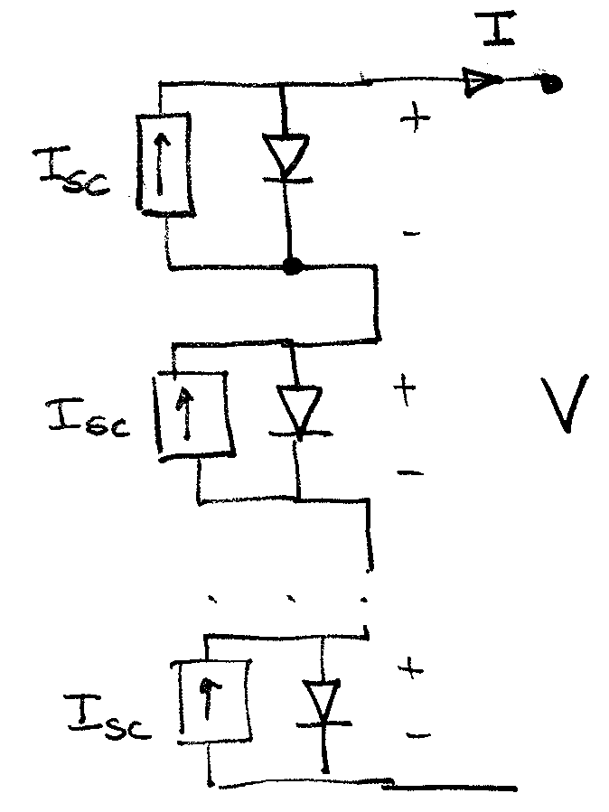
Module w/ “Simple Cell” Model
Using the simplest cell model
For one cell (in the sun)

Slide 11
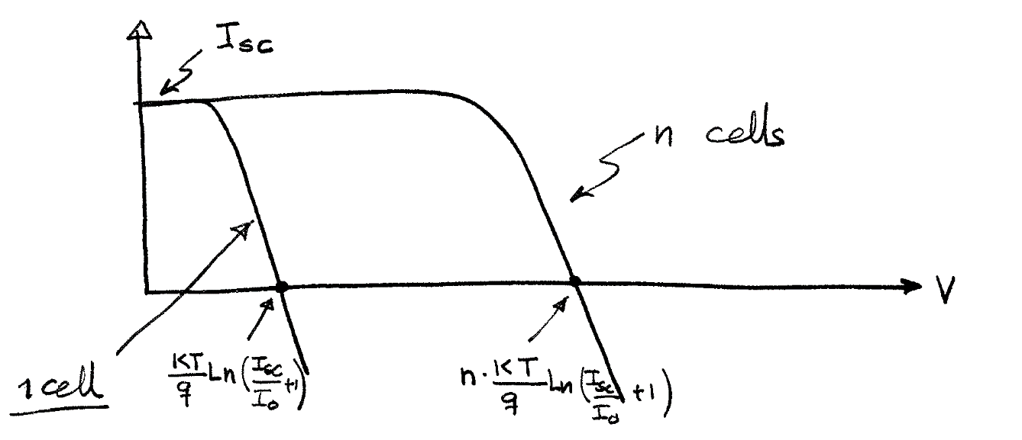
Module with “Simple Cell” Model
For the entire module

Slide 12
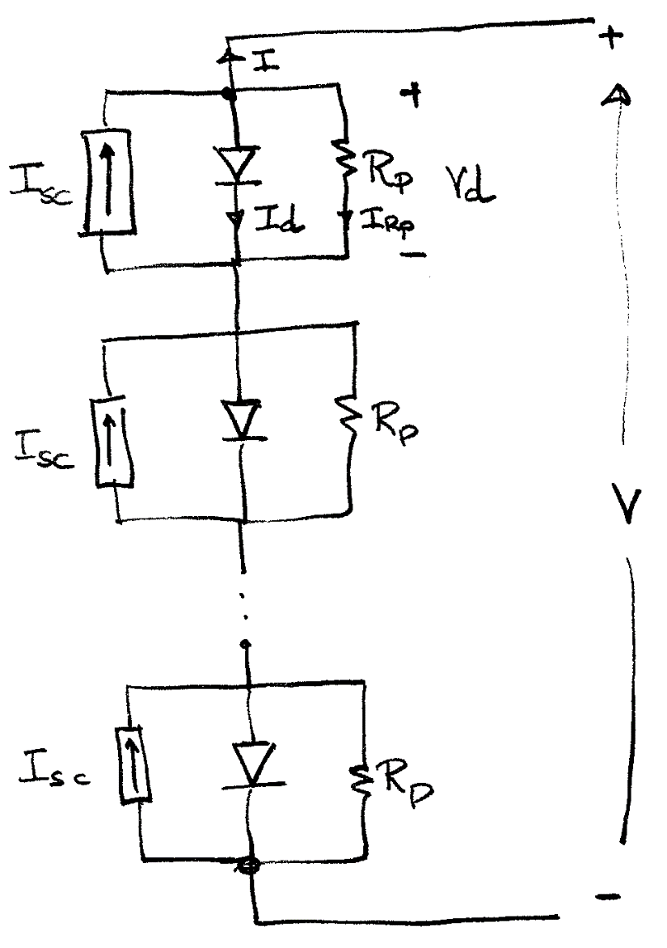
Module w/ “Parallel-Only” Cell Model
For one cell (in the sun)
For the entire module

Slide 13
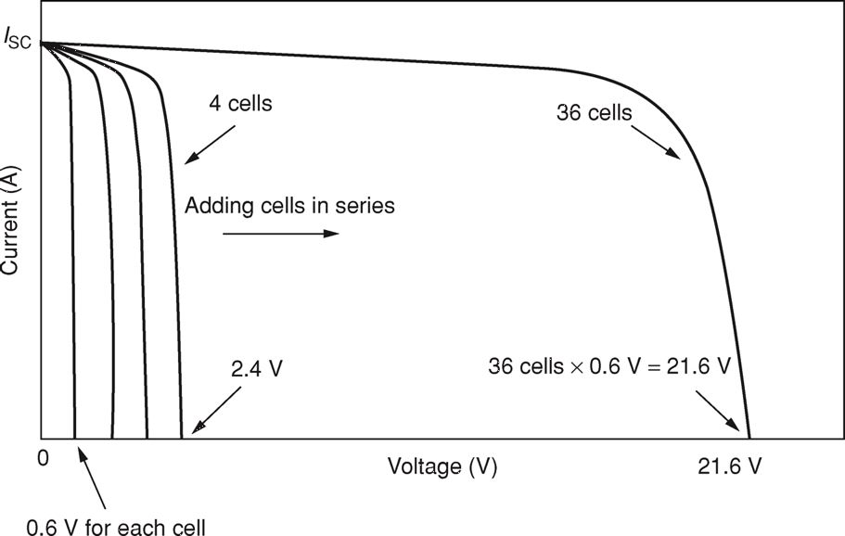
Module Example
Assume 36 identical cells in series w/
I₀ = 5×10⁻¹¹ A
I_{sc}=5A
At 25°C what is V_{oc}?
R_{p}= 10Ω
R_{s} = 0 Ω
FIGURE 5.34
For cells wired in series, their voltages at any given current add.
Masters, Gilbert M. Renewable and Efficient Electric Power Systems, 2nd Edition. Wiley-Blackwell
Again, an iterative solution is needed and yields: V = 23.41

Slide 14
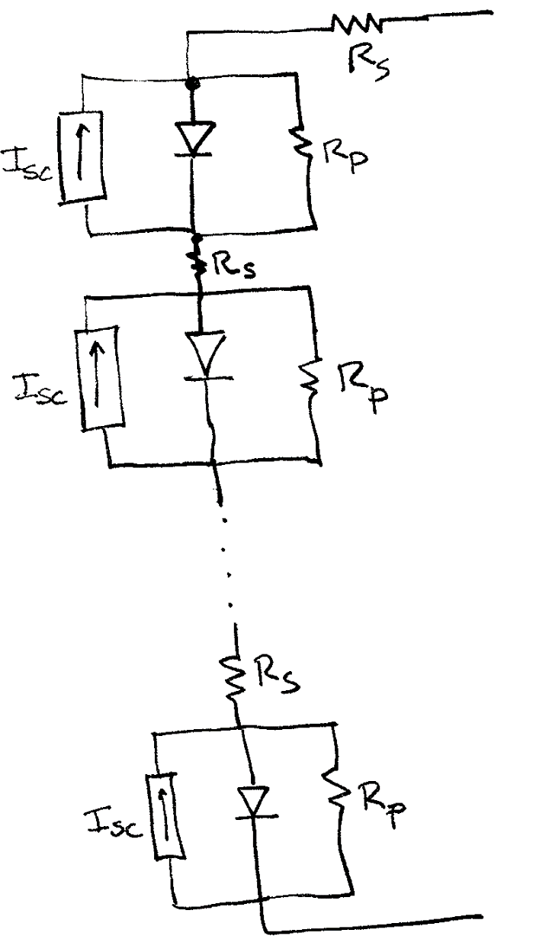
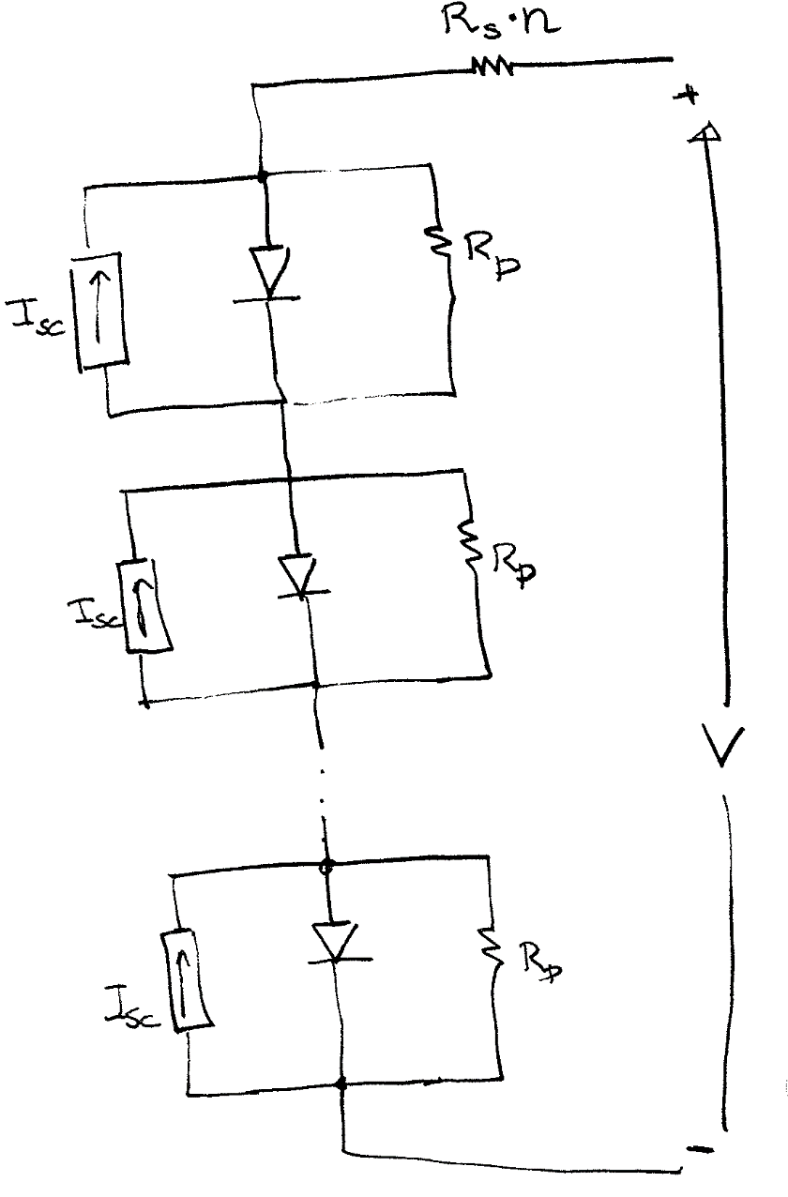
Module with General Cell Model

Slide 15
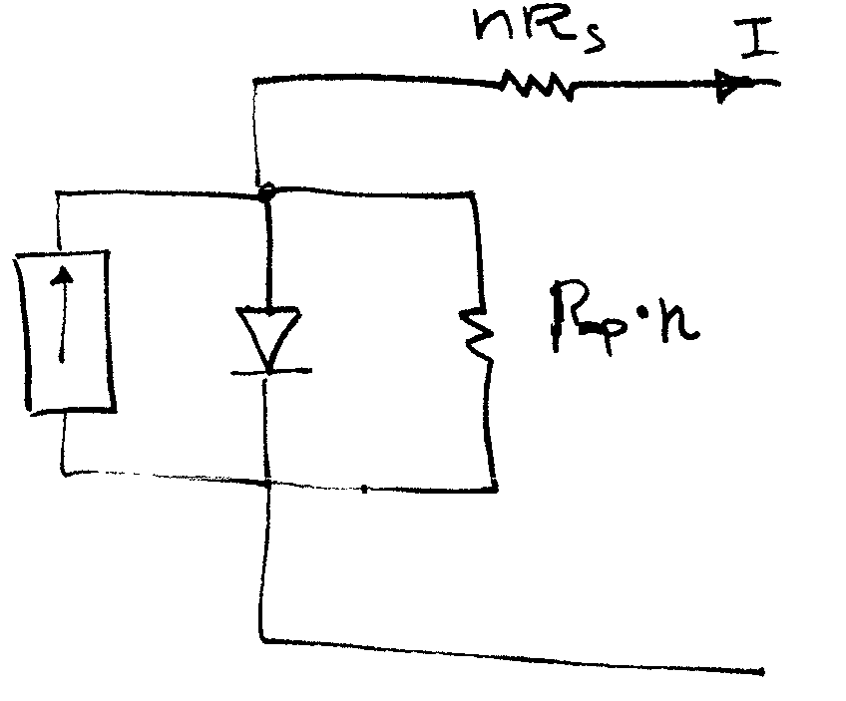
Module w/ “General Cell” Model
For the entire module
+
V
-
Writing the equations in terms of V and I

Slide 16
Module Example Continued: V-I Curve
Generating the V-I Curve again requires picking a V_{d}
Pick a value of V_{d}
Solve for I_{d}
Solve for I_{p}
I = I_{sc} – I_{d} – I_{p}
V = n(V_{d} – R_{s} · I)

Slide 17
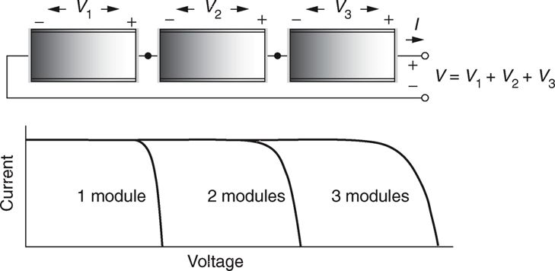
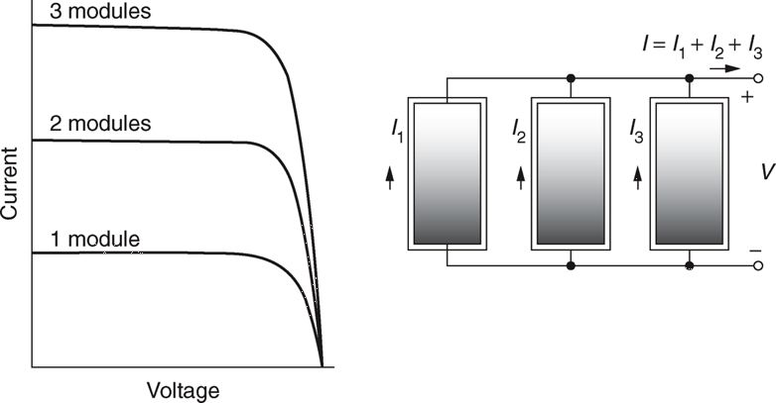
Cells Wired to form Modules
Modules in series increase the voltage
FIGURE 5.35 For modules in series, at any given current the voltages add.
Masters, Gilbert M. Renewable and Efficient Electric Power Systems, 2nd Edition. Wiley-Blackwell
Modules in parallel increase the current
FIGURE 5.36 For modules in parallel, at any given voltage the currents add.
Masters, Gilbert M. Renewable and Efficient Electric Power Systems, 2nd Edition. Wiley-Blackwell.

Slide 18
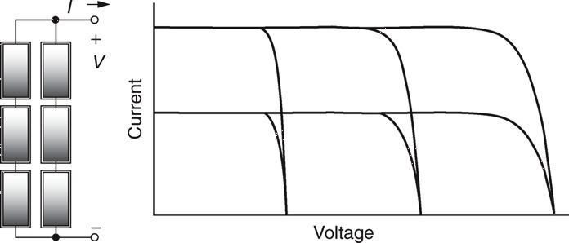
Cells Wired to form Modules
Cells can also be wired in series and parallel combinations
Terminal Voltage and Currents add as linear combinations of strictly series or parallel modules.
FIGURE 5.37 The total I–V curve of an array consisting of two strings of three modules each
Masters, Gilbert M. Renewable and Efficient Electric Power Systems, 2nd Edition. Wiley-Blackwell.

Slide 19
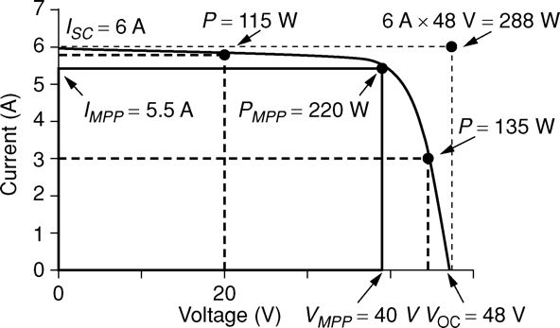
Standard Test Conditions
Standard PV Test Conditions are 1 kW/m² , 25°C, 1.5 AMR
Cell rating is the Maximum Power Point (MPP) power
Fill factor (FF) is ratio of MPP to V_{oc} × I_{sc}
FIGURE 5.41 The maximum power point (MPP) corresponds to the biggest rectangle that can fit beneath the I–V curve.
Masters, Gilbert M. Renewable and Efficient Electric Power Systems, 2nd Edition. Wiley-Blackwell

Slide 20
Impact of Temperature and Insolation
Cell output is sensitive to T and Insolation
V_{oc} drops by ~ $\frac{0.33\%}{oC}$ (panel dependent – check spec sheet)
S – Insolation (kW/m²)
NOCT – Nominal Operating Cell T. (panel spec)
Industry standard is that NOCT reported @
20º C ambient and
0.8 (kW/m²) and
wind @ 1 m/s
FIGURE 5.42 I-V characteristic curves under various cell temperatures for a Kyocera KC120-1 PV module.
Masters, Gilbert M. Renewable and Efficient Electric Power Systems, 2nd Edition. Wiley-Blackwell

Slide 21
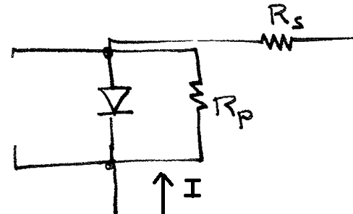
PV Module Shading
PV module output can be severely reduced (>50%) w/ small portion shaded
A single shaded cell in a long cell string limits current in all cells
I_{SC} depends directly upon Insolation: ↓ S → ↓ I
Each cell in series must carry the same current (KCL !!)
In essence, a shaded PV cell is modeled as a resistor (vice a current source || w/ a diode )
I_{sc} = zero
Reverse biased diode (off)
I flows through R_{p}, R_{S}

Slide 22
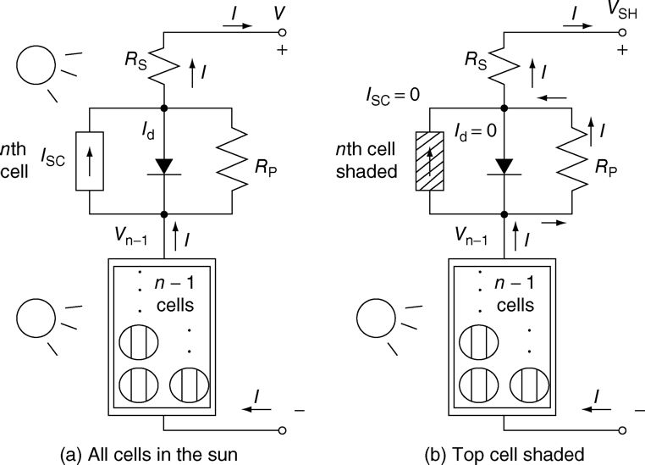
Shading Impact on Output Voltage
I
I
+
+
I
I
I
I
I
I
V_{SH}
I
_
_
I
FIGURE 5.43 n-cell module in which (a) all cells are in the sun or (b) the top cell is completely shaded.
Masters, Gilbert M. Renewable and Efficient Electric Power Systems, 2d Ed.
Voltage across n non-shaded cells
or n-1 non-shaded cells

Slide 23
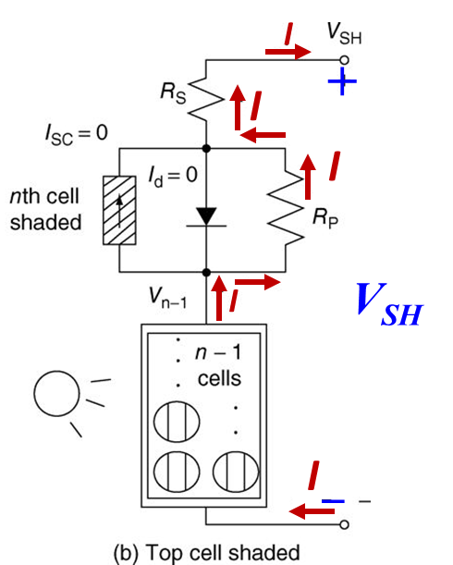
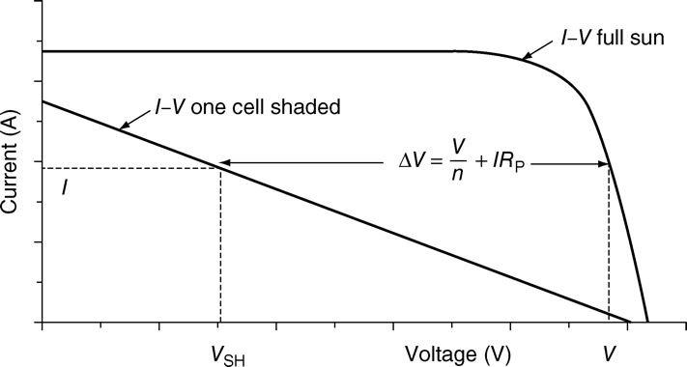
Voltage Output w/ Shading – V_{SH}
R_{p} >> R_{s}
FIGURE 5.44 Effect of shading one cell in an n-cell module.
Masters, Gilbert M. Renewable and Efficient Electric Power Systems, 2d Ed.

Slide 24
Voltage Output w/ Shading – Example
PV Module: 72 cells in Series
I_{SC} = 6.0 A @ 25ºC
I_{o} = 5 x 10⁻¹¹ A
R_{p} = 10 Ω
R_{s} = 0.001 Ω
4.38 A
2.24 A

Slide 25
Voltage Output w/ Shading – Example (cont)
4.38 A
2.24 A
Cell Shading Impacts Power Output !!

Slide 26
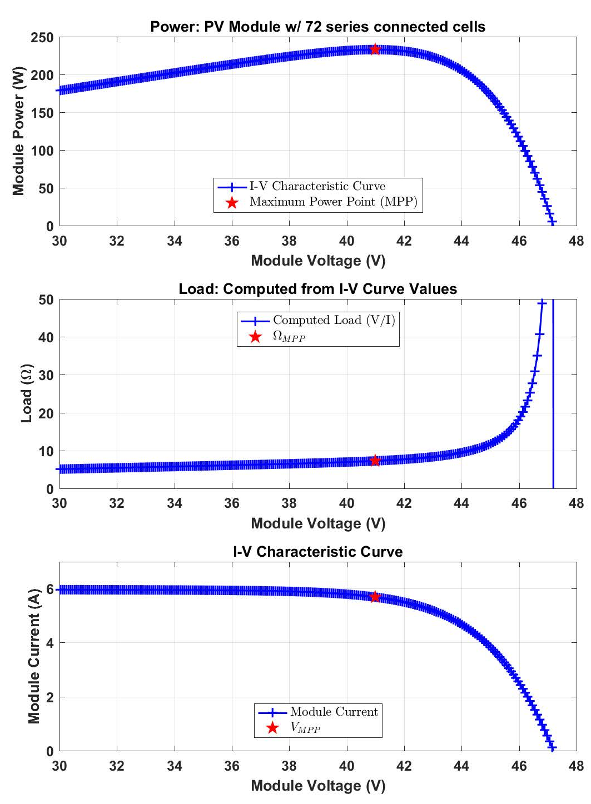
PV Module Operating Point
What Determines the PV Module’s Operating point??
$$R_{load}$$
$$\frac{1}{R_{load}}$$

Slide 27
Shading Example 2
36 cell PV module w/ R_{p} = 6.6 Ω per cell.
In full sun, I = 2.14 A & V = 19.41 V.
P_{out} = 41.5 W.
If a cell is shaded & the I stays the same, what are the new output voltage and power?
With one cell shaded the output is < 25% of original! Lost power is dissipated as heat in the shaded cell.

Slide 28
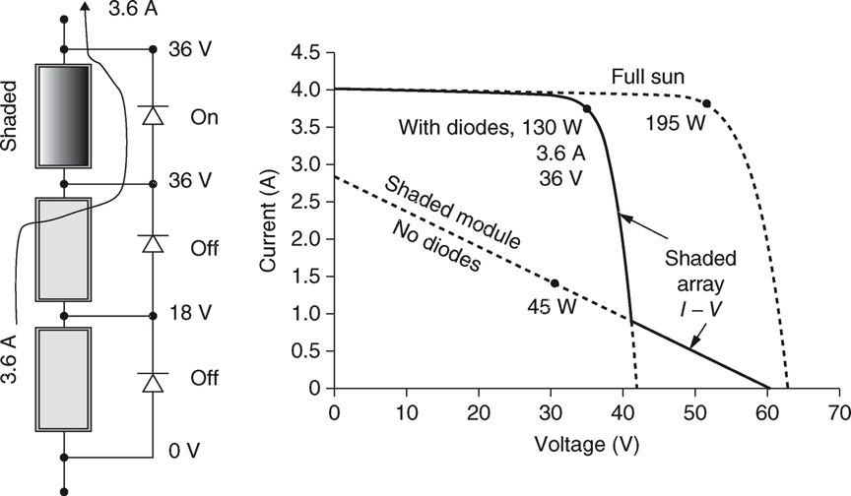
Shading Mitigation
Solution – bypass the shaded cell w/ diodes
Replace I ·(R_{p}+R_{s} ) resistive w/ ~.6 V diode voltage drop
No other effects under normal operation
FIGURE 5.50 Using bypass diodes to mitigate shading impact in a string of modules
Masters, Gilbert M. Renewable and Efficient Electric Power Systems, 2nd Edition. Wiley-Blackwell

Slide 29
Bypass Diode Impact on Module
FIGURE 5.50 Showing the ability of bypass diodes to mitigate shading problems in a string of modules
Masters, Gilbert M. Renewable and Efficient Electric Power Systems, 2nd Edition. Wiley-Blackwell

Slide 30
PV Module Operating Point
What Determines the PV Module’s Operating point??
$$R_{load}$$
$$\frac{1}{R_{load}}$$

Slide 31
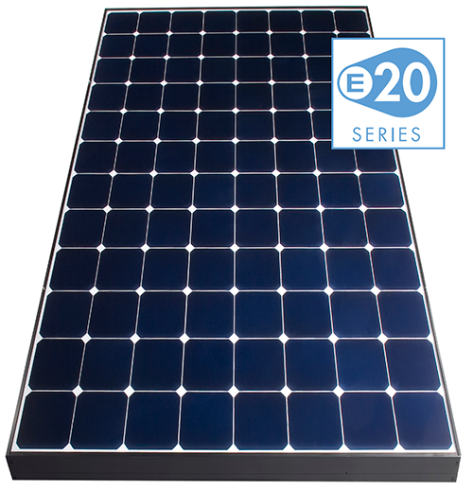
Monocrystalline Silicon (mono-si)
Also called crystalline silicon
Made out of high grade silicon ingots that are cylindrical in shape
Their edges are cut
Even coloring and uniform look
These panels cost more, but have higher efficiency and longer life
Ex: SunPower E20 series w/ 20% efficiency
Image: http://solargaincommercial.com.au/sites/default/files/sunpower-solar-power-module.png

Slide 32
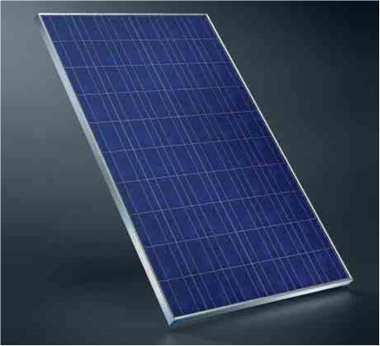
Polycrystalline Silicon (p-Si) or Multi-cyrstalline Silicon (mc-Si)
Oldest of the commercial PV panels
Silicon is melted and poured into square molds
Result is square wafers, with no side cuts
Speckled appearance
Advantages:
Less expensive
less waste
Disadvantage:
lower efficiency (13-16%)
Image: http://dev.msbs.net/Portals/0/images/PolycrystallineSolarPanel.jpg

Slide 33
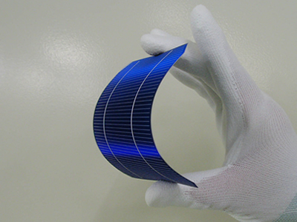
Thin-Film Solar Cells
Thin-film solar cells are created by depositing one or more layers of material onto the substrate
Examples include amorphous silicon (a-Si), gallium arsenide (GaAs), cadmium telluride (CdTe), copper indium gallium selenide (CIS)
Advantages are that they are simple to mass produce, have a uniform appearance, and can be flexible
Disadvantages are they are not very efficient, and may degrade faster
Image: http://www.thesolarco.com/images/Why-Choose-Monocrystalline-Technology_amorphous.jpg

